Slide 1

Artificial Intelligence
Revolution
Transforming the Future

Slide 2


02
Introduction
Artificial Intelligence (AI) is a branch of computer science focused on creating machines capable of performing tasks that typically require human intelligence. These tasks include learning, reasoning, problem-solving, and understanding natural language. AI is transforming various industries, making processes more efficient and creating new opportunities.

Slide 3


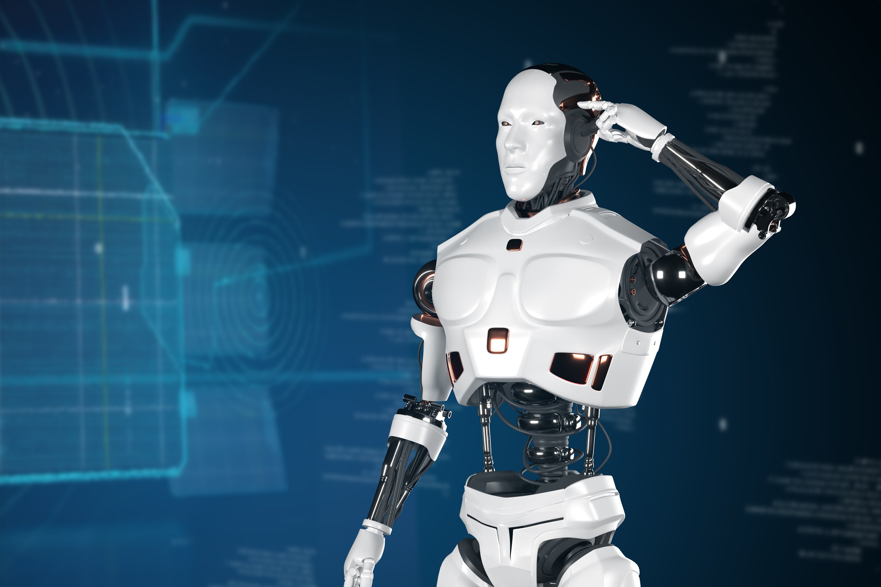
03
Evolution of AI
The concept of AI dates back to ancient times, but modern AI research began in the mid-20th century. Early milestones include the development of the Turing Test, the creation of the first AI programs in the 1950s, and the advent of machine learning algorithms in the 1980s. AI has since evolved rapidly, driven by advances in computing power and data availability.

Slide 4



04
Types of AI
NARROW AI
GENERAL AI
SUPERINTELLIGENT AI
Designed for specific tasks like facial recognition or voice assistants. It excels at its function but lacks general intelligence.
Mimics human intelligence across various activities, learning and applying knowledge in different contexts.
A theoretical AI that surpasses human intelligence in all aspects, with potential for both great benefits and significant risks.

Slide 5

05
Machine Learning
Machine learning is a subset of AI that enables systems to learn from data and improve over time without being explicitly programmed. It involves various techniques, such as supervised learning, unsupervised learning, and reinforcement learning. Machine learning is widely used in applications like recommendation systems, image recognition, and natural language processin

Slide 6
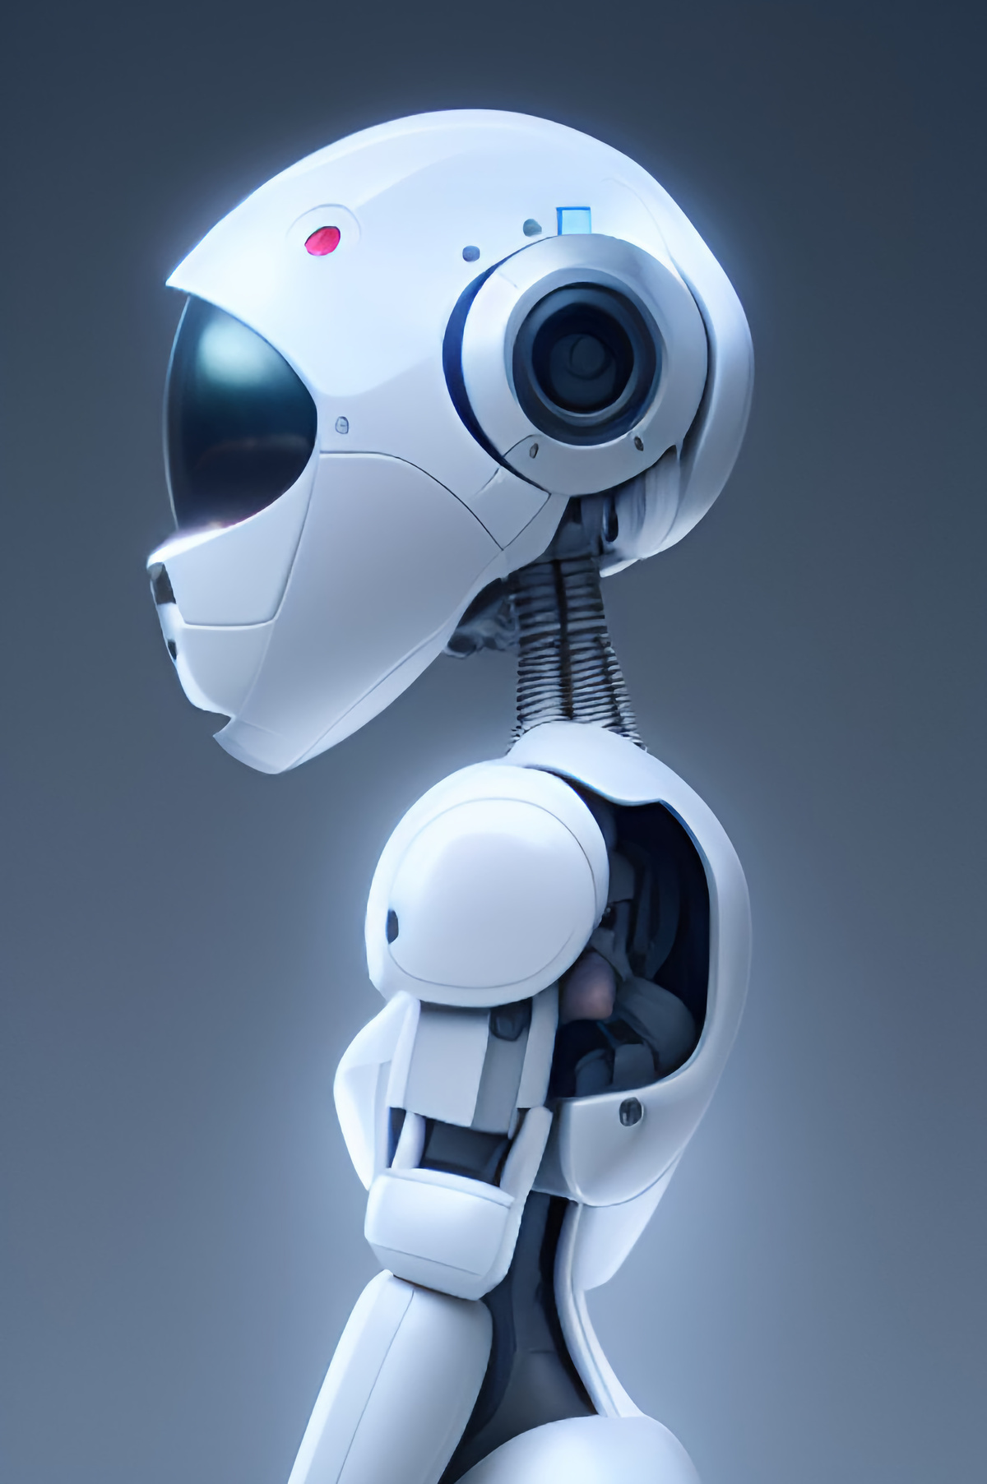
06
Deep Learning
Deep learning, a subset of machine learning, utilizes neural networks with multiple layers to analyze complex data patterns. This approach has led to breakthroughs in image and speech recognition, autonomous driving, and more. Deep learning models, such as convolutional neural networks (CNNs) and recurrent neural networks (RNNs), have significantly enhanced AI capabilities.

Slide 7
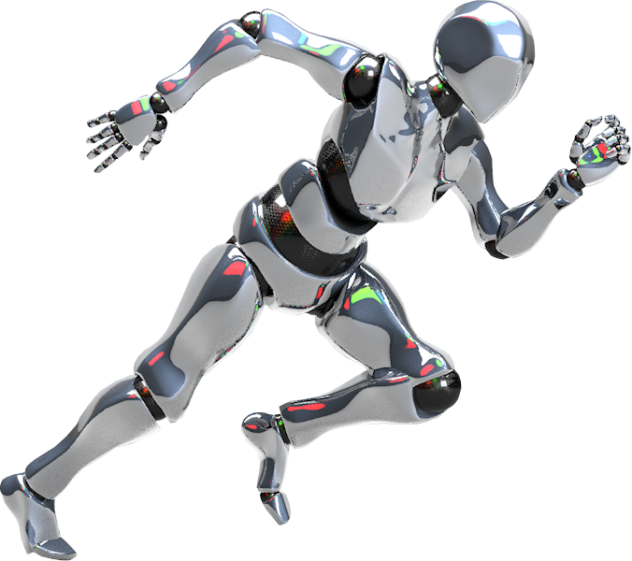
07
Understanding Language
Natural Language Processing (NLP) is a field of AI that focuses on the interaction between computers and humans through natural language. NLP enables machines to understand, interpret, and respond to human language in a meaningful way. Applications of NLP include chatbots, language translation, sentiment analysis, and voice-activated assistants.

Slide 8
8
Responsible AI
The rise of AI brings significant ethical considerations. Issues such as bias in AI algorithms, privacy concerns, and the impact on employment must be addressed. Ensuring responsible AI development involves creating transparent, fair, and accountable systems. Ethical guidelines and regulations are crucial to mitigate potential negative impacts and ensure AI benefits all of society.

Slide 9
9
Irresponsible AI
The misuse of AI technology presents significant risks. Unchecked AI systems can perpetuate biases, making unfair decisions that disproportionately affect marginalized groups. Privacy violations are a major concern, as AI often collects and analyzes vast amounts of personal data without adequate safeguards. Furthermore, irresponsible AI deployment can disrupt labor markets and cause economic inequality.

Slide 10
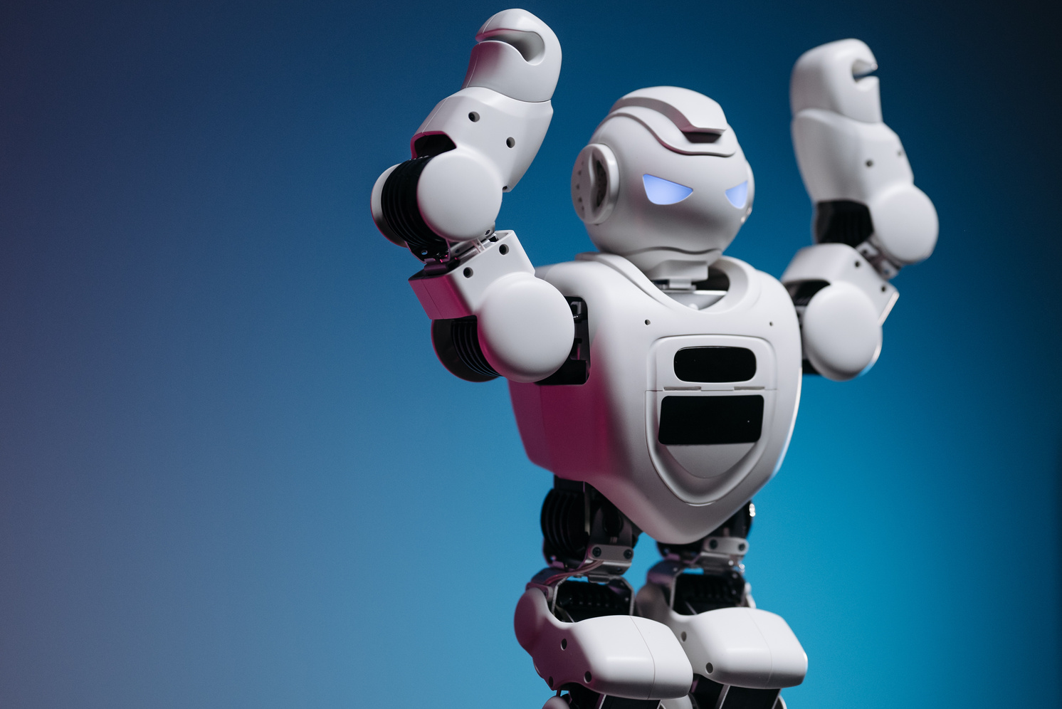
10
Challenges and Opportunities
Navigating the Path Ahead While AI offers numerous benefits, it also presents challenges such as technical limitations, ethical dilemmas, and the need for skilled professionals. Addressing these challenges requires collaboration between academia, industry, and policymakers. The ongoing development and deployment of AI technologies will create new opportunities and shape the future workforce.

Slide 11
Thank You!
Thank you for exploring the world of AI with us. For more information, please contact us at
DUDDUKUNTA JYOTHI

